Slide 1
IoT Security Enhancement using Physical Layer signatures
PROJECT GUIDE : MRS. N. VIJAYA
NARAYANAN B - 2016105053
VENKAT KRISHNAN B K J - 2016105077
ASHOK KUMAR M - 2016105513

Slide 2
INTRODUCTION
Wireless networks are susceptible to various attacks due to the “open air” nature of the wireless communication
A secure wireless communication system involves authentication and secure transmission
Authentication verifies the user identity and prevents malicious users from accessing the network
Secure transmission protects data integrity and confidentiality using encryption schemes
IoT Security
Devices are low powered and mostly battery operated
Flawed because of the operational limitations on the computational power
Physical layer signatures
Fine-grained values derived from the physical layer, such as RSS and CSI.
Very sensitive to location and time
Presents an excellent quality of randomness

Slide 3
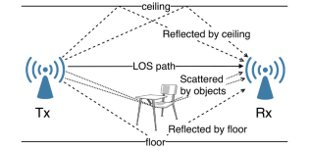
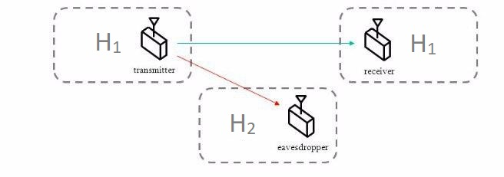
Various factors affecting the signal
Channel Model

Slide 4
MOTIVATION
Drawbacks of Conventional Cryptography Techniques
Due to the “open-air” nature, key distribution is more susceptible to attacks in wireless communications.
Mathematically Complex in the case of IoT devices
Physical Layer Security
It involves physical layer signatures which are very random, unique and doesn’t involves complex mathematical computations
Physical Layer Security + Cryptographic Techniques
Existing cryptographic securities can be enhanced with the incorporation of physical layer signatures

Slide 5
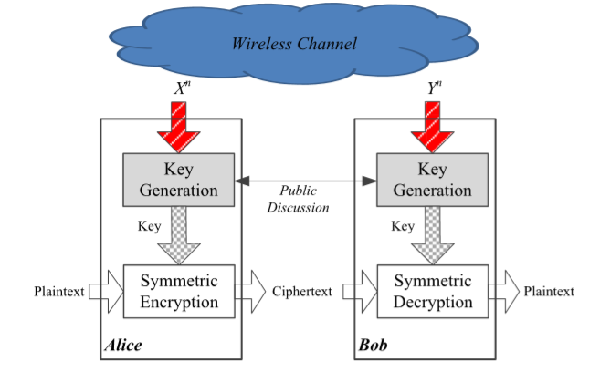
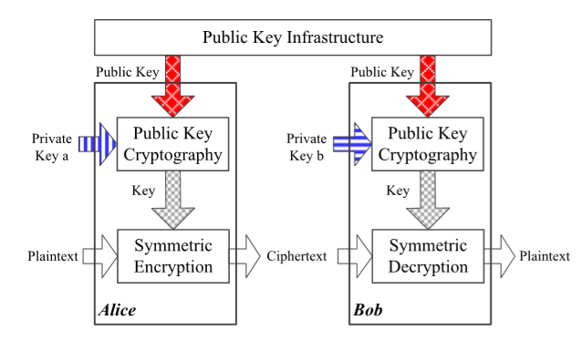
Existing Method Proposed Method

Slide 6
OBJECTIVE
To develop a new secret key generation algorithm using physical layer signatures (Channel State Information).
To overcome key exchange, key distribution and key management overhead at legitimate users.
To provide significant improvement in secrecy.

Slide 7
METHODOLOGY
CSI
CSI
K
K
MAC
E
||
D
MAC
Hash
Hash
E
E
K
K
Verification
 | Encryption
K | Key
 | Decryption
E
Yes
D
Authenticated User

Slide 8
FLOWCHART
CSI EXTRACTION
S_{i}
QUANTIZATION
K_{u}
PRIVACY AMPLIFICATION
SHA - 256
K

Slide 9
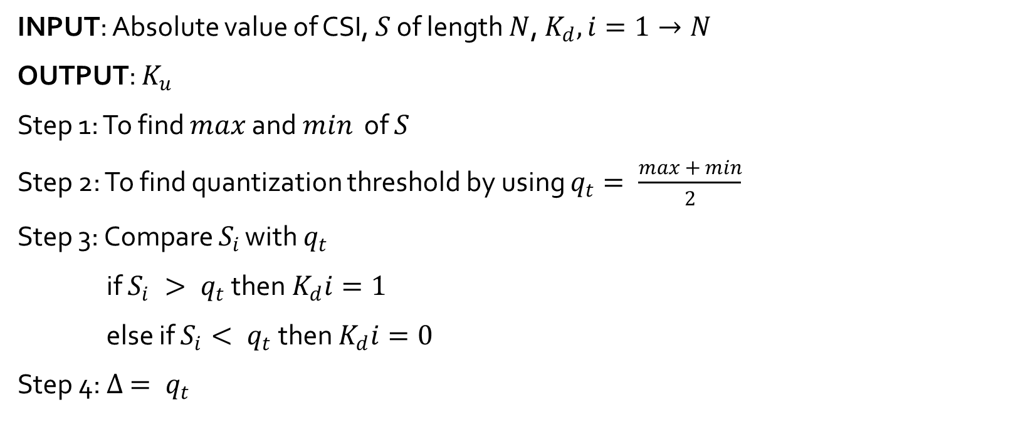
QUANTIZATION ALGORITHM
INPUT: Absolute value of CSI, $S$ of length $N$, $K_{d}, i=1→N$
OUTPUT: $K_{u}$
Step 1: To find $max$ and $min$ of $S$
Step 2: To find quantization threshold by using $q_{t}= \frac{\max{+ min}}{2}$
Step 3: Compare $S_{i}$ with $q_{t}$
if $S_{i} > q_{t}$ then $K_{d}i=1$
else if $S_{i}< q_{t}$ then $K_{d}i=0$
Step 4: $∆ = q_{t}$

Slide 10

Step 5: while$\left(no. of zeros in K_{d} ==no. of ones in K_{d}\right)$
$∆=\frac{∆}{2}$
if $no. of zeros in Kd > \frac{N}{2}$
$q_{t}=q_{t}− ∆$
if $no. of ones in Kd > \frac{N}{2}$
$q_{t}=q_{t}+ ∆$
Compare $S_{i}$ with $q_{t}$
if $S_{i} > q_{t}$ then $K_{d}i=1$
else if $S_{i}< q_{t}$ then $K_{d}i=0$
Step 6: $K_{u}= K_{d}$

Slide 11
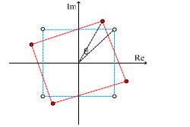

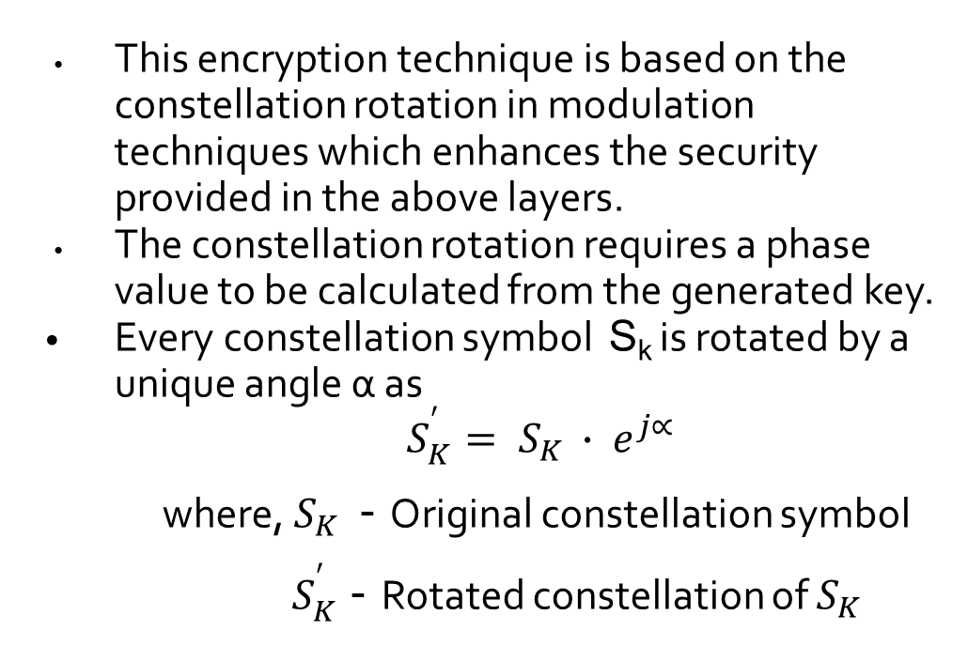
ENCRYPTION
This encryption technique is based on the constellation rotation in modulation techniques which enhances the security provided in the above layers.
The constellation rotation requires a phase value to be calculated from the generated key.
Every constellation symbol S_{k} is rotated by a unique angle α as
$S_{K}^{′}= S_{K }∙ e^{j∝}$
where, $S_{K }$ - Original constellation symbol
${ S}_{K}^{′}$ - Rotated constellation of $S_{K }$

Slide 12
PHASE CALCULATION
To generate an unique angle with respect to the generated key.
The 256 bit key is split into 8 bit words to find 32 phases.
 | Bits used to determine the quadrant of the phase
 | Sign Bits
 | Magnitude Bits

Slide 13
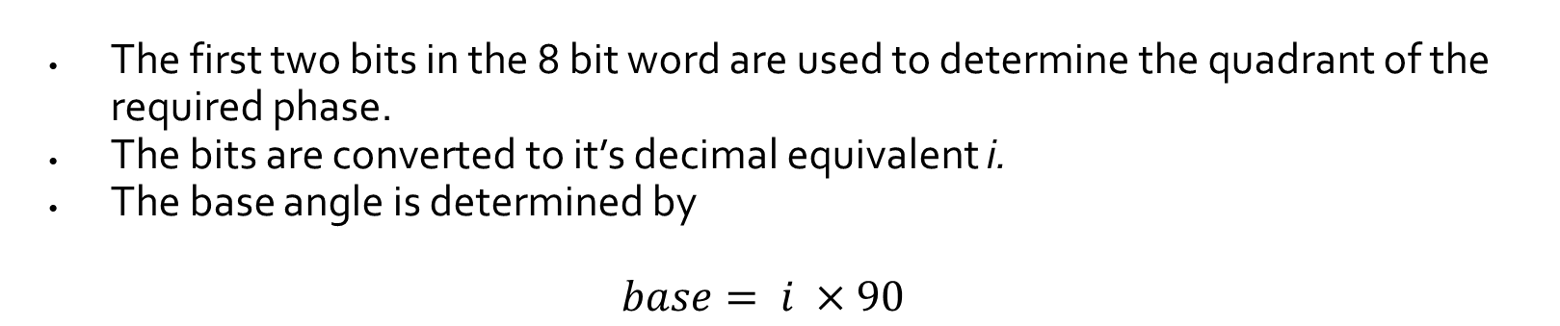
QUADRANT BITS
a₁ | a₂
The first two bits in the 8 bit word are used to determine the quadrant of the required phase.
The bits are converted to it’s decimal equivalent i.
The base angle is determined by
$$base= i ×90$$
SIGN BIT
b
If b is 0, the constellation is rotated in the anticlockwise direction.
If b is 1, the constellation is rotated in the clockwise direction.

Slide 14
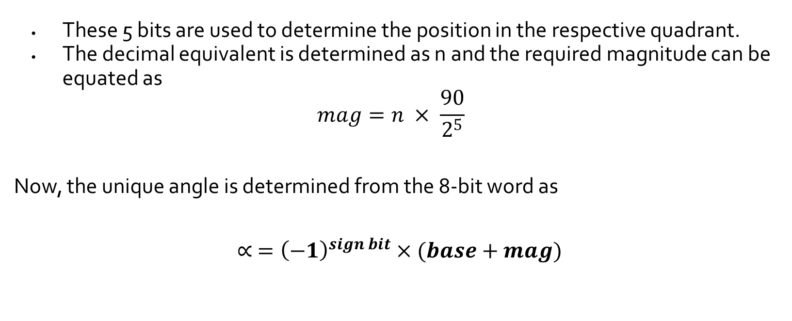
MAGNITUDE BITS
C₁ | C₂ | C₃ | C₄ | C₅
These 5 bits are used to determine the position in the respective quadrant.
The decimal equivalent is determined as n and the required magnitude can be equated as
$$mag=n × \frac{90}{2^{5}}$$
Now, the unique angle is determined from the 8-bit word as
$$∝ ={\left(−1\right)}^{sign bit}×(base+mag)$$

Slide 15
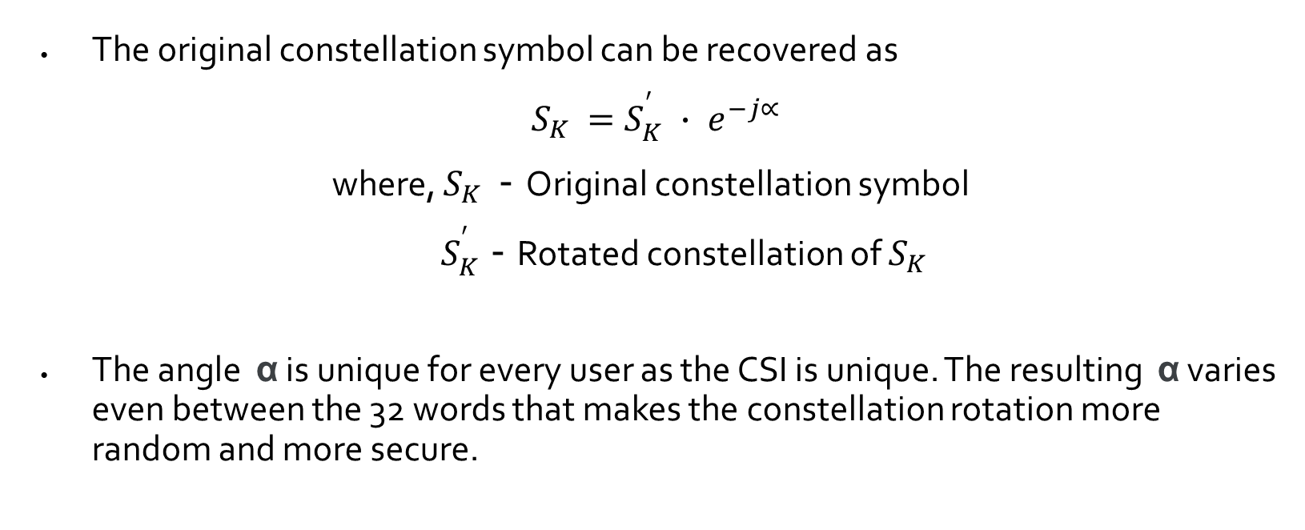
DECRYPTION
The original constellation symbol can be recovered as
$S_{K }=S_{K}^{′} ∙ e^{−j∝}$
where, $S_{K }$ - Original constellation symbol
${ S}_{K}^{′}$ - Rotated constellation of $S_{K }$
The angle α is unique for every user as the CSI is unique. The resulting α varies even between the 32 words that makes the constellation rotation more random and more secure.

Slide 16
PERFORMANCE METRICS
MISMATCH RATE
Mismatch rate is defined to be ratio of mismatched bits between the secret keys independently generated by the user and the provider.
In the coherence time interval, the mismatch rate is ideally zero between the sender and receiver, but practically due to noise, distortion etc., it is a very low value.
LEAKAGE RATE
Leakage measures the amount of information learned by the adversary.
Leakage is defined to be the ratio of matched bits between the sender and the adversary. An encryption scheme with lower leakage is more secure.

Slide 17
PERFORMANCE METRICS
BER PERFORMANCE
The bit error ratio (also BER) is the number of bit errors divided by the total number of transferred bits during a time interval.
The evaluations show that the bit error decreases with an increase in SNR for the intended user but the bit error remains constant even with an increase in SNR for the adversary.
KEY VARIATION WITH TIME
The CSI is generally very sensitive to variations with time. The key generated by the different users at different time intervals even at the same location are hence unique and random.
A higher key variation will result in better security.

Slide 18
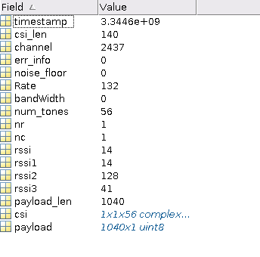
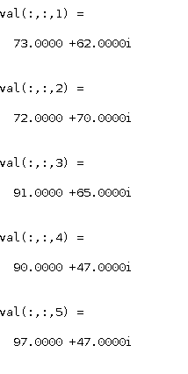
RESULTS
Data extracted from NIC
Sample CSI data

Slide 19
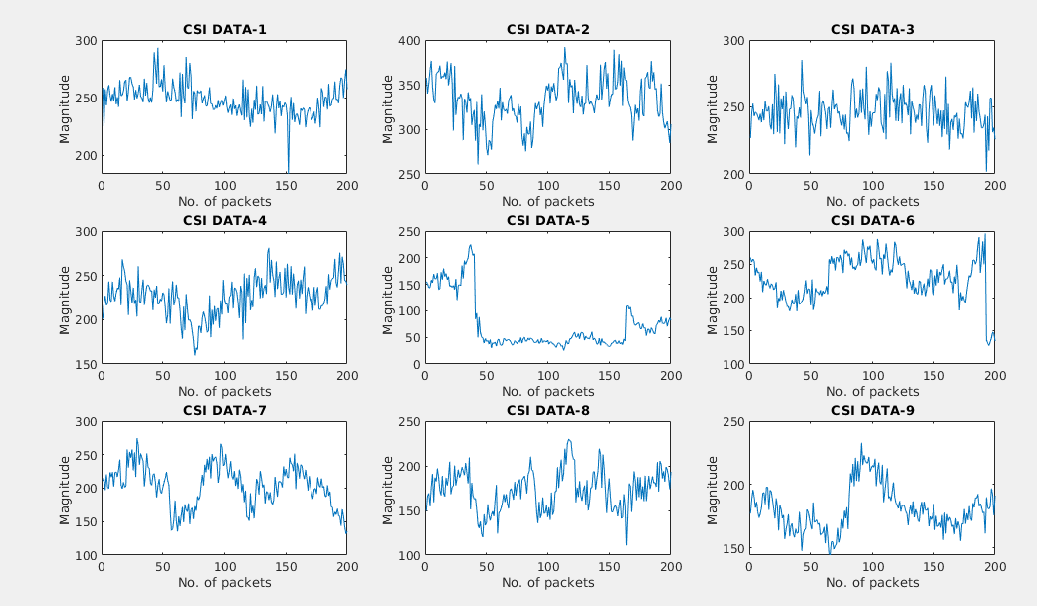
CSI Samples varying with respect to distance and time

Slide 20
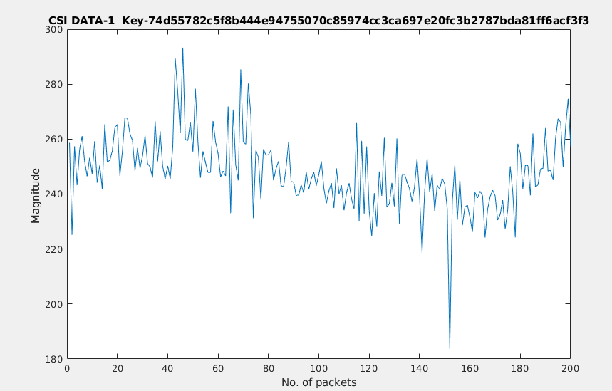
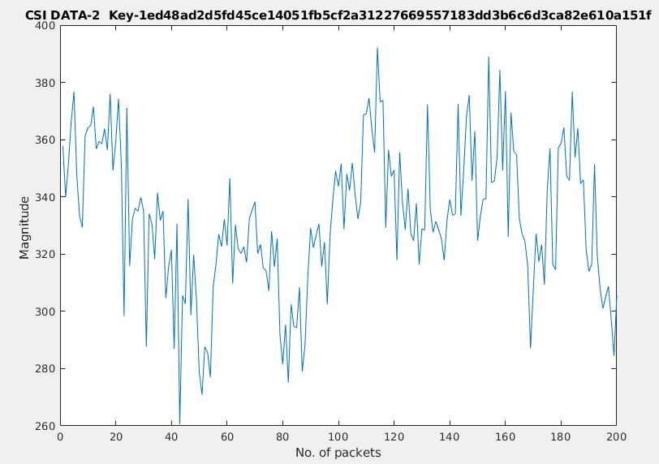
Keys generated for different CSI values

Slide 21
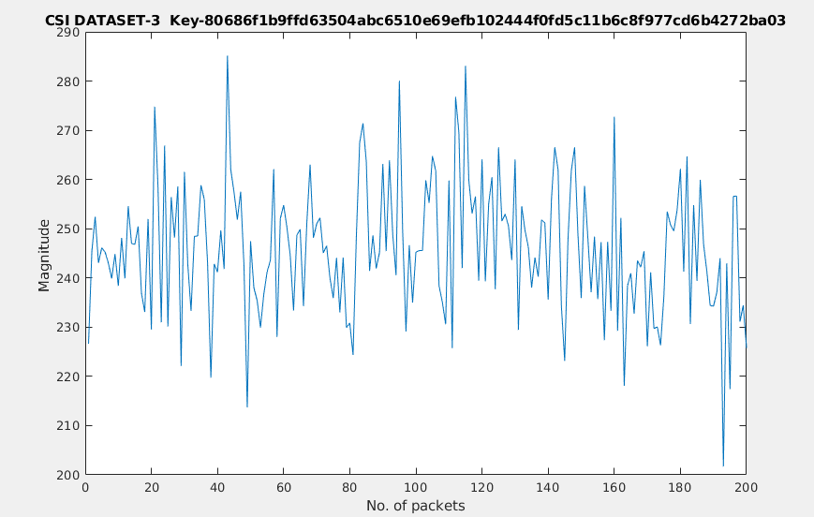
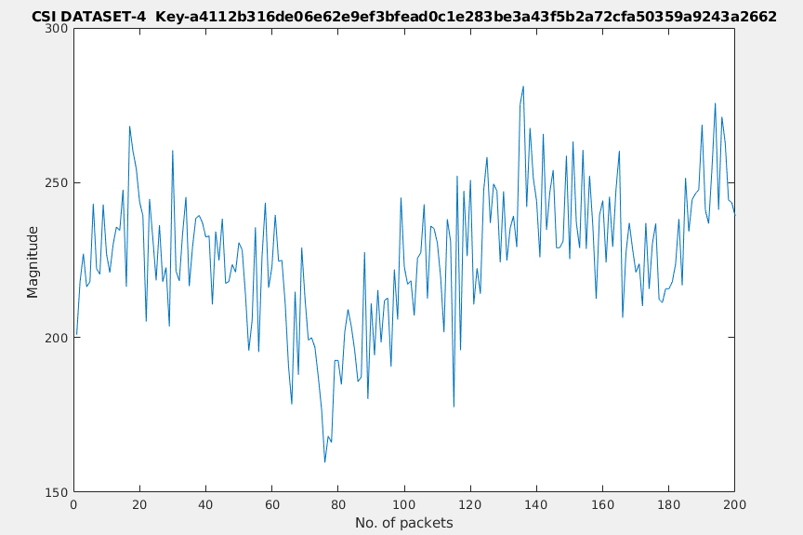
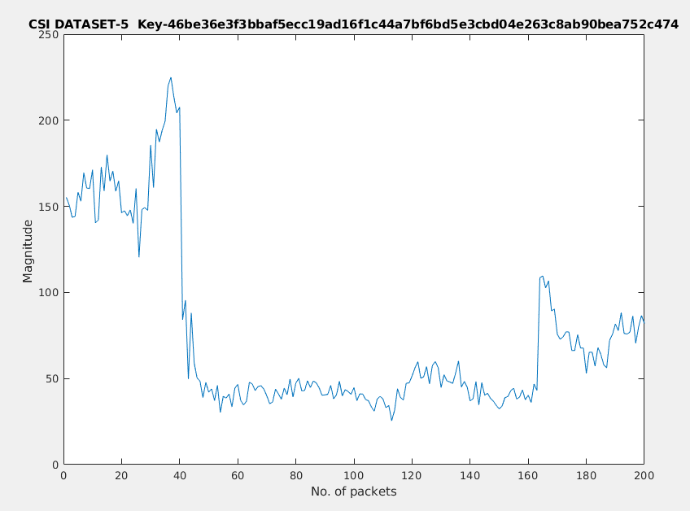
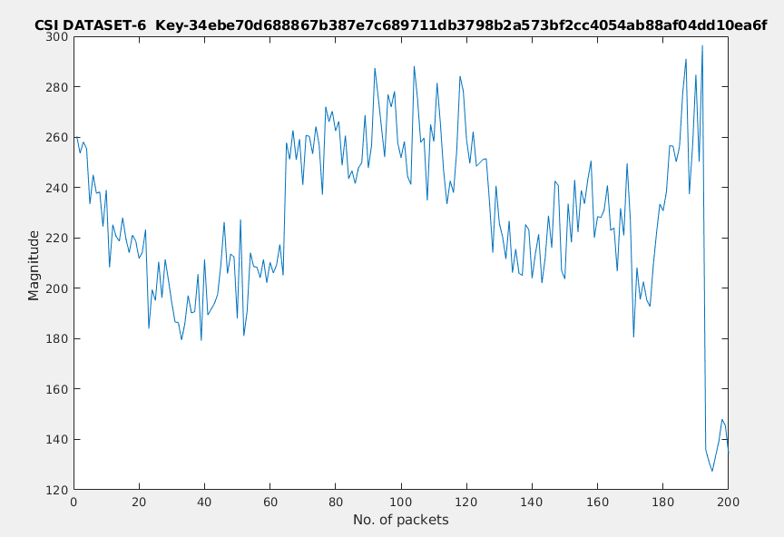

Slide 22
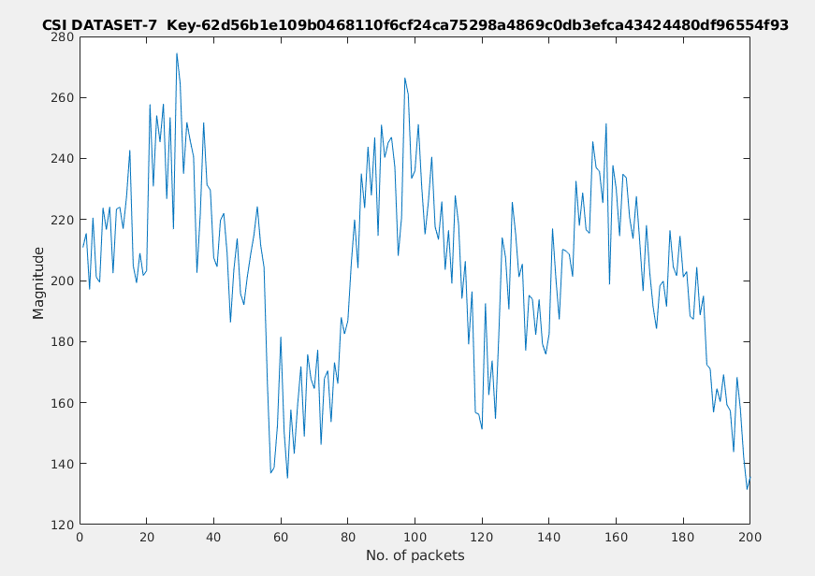
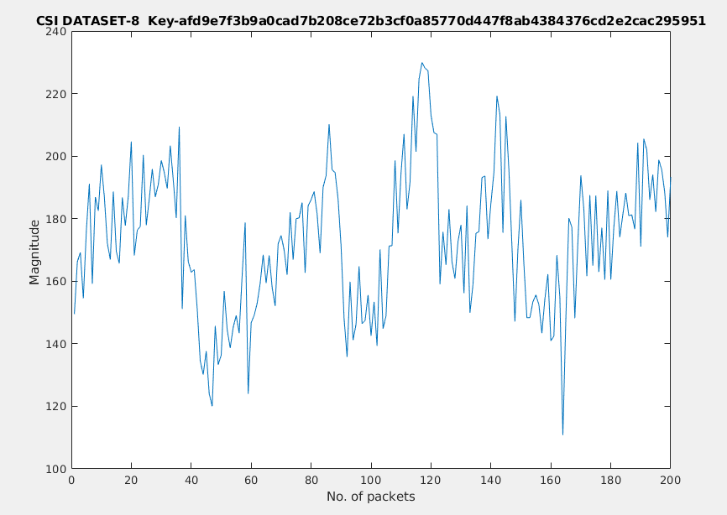
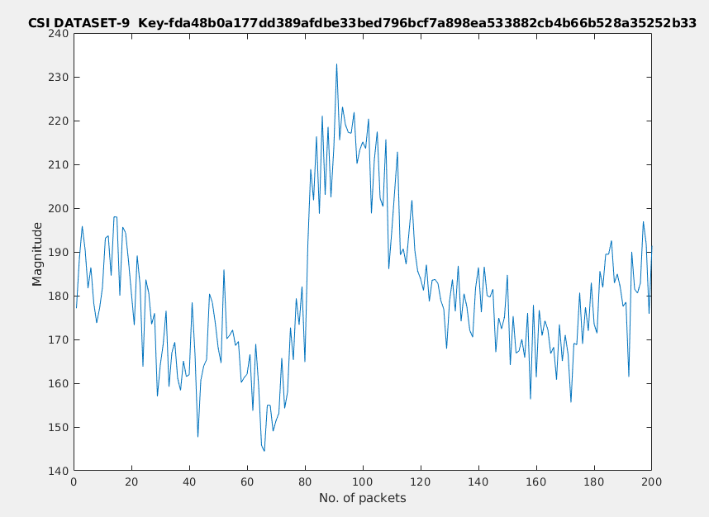

Slide 23
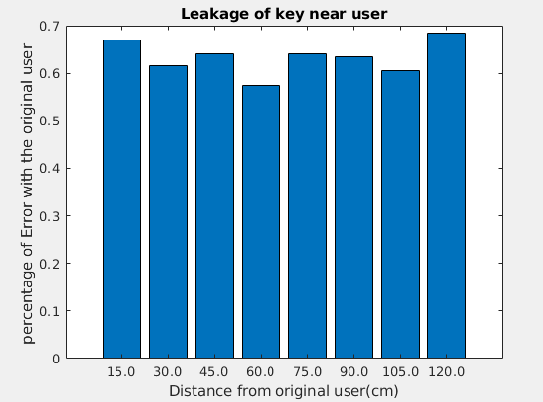
PERFORMANCE METRICS
LEAKAGE RATE

Slide 24
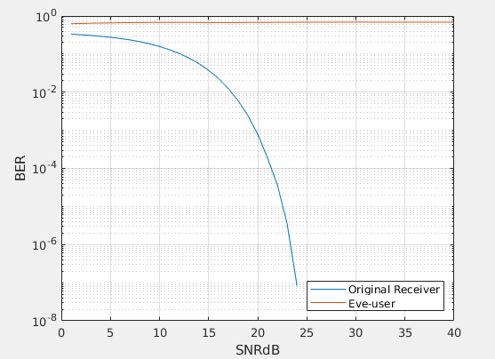
BER PERFORMANCE OF DIFFERENT MODULATION SCHEMES
QAM-16

Slide 25
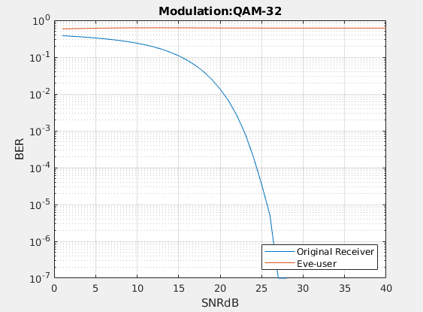
BER PERFORMANCE OF DIFFERENT MODULATION SCHEMES
QAM-32

Slide 26
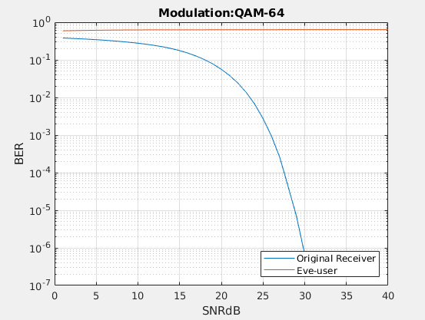
BER PERFORMANCE OF DIFFERENT MODULATION SCHEMES
QAM-64

Slide 27
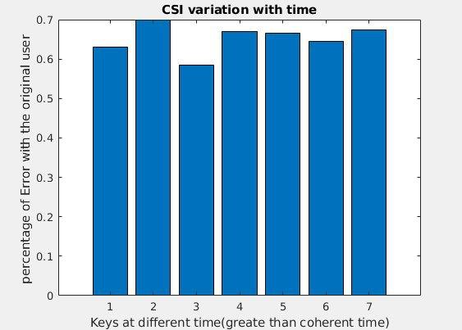
KEY VARIATION WITH TIME

Slide 28
REFERENCES
Physical Layer Security for the Internet of Things by Junqing Zhang, Sekhar Rajendran, Zhi Sun, Member, IEEE, Roger Woods, Senior Member, IEEE, and Lajos Hanzo, Fellow, IEEE. Published in: IEEE Wireless Communications (Volume:26, Issue: 5, October 2019)
Key Generation From Wireless Channels: A Review by Junqing Zhang, Trung Q. Duong, (Senior Member, IEEE), Alan Marshall, (Senior Member, IEEE), and Roger Woods, (Senior Member, IEEE) 2016. Published in: IEEE Access (Vol. 4)
Wireless Physical Layer Identiﬁcation : Modeling and Validation, by W.Wang, Z.Sun, S. Piao, B. Zhu, and K. Ren, IEEE Trans. Inf. Forensics Security, vol. 11, no. 9, pp. 2091–2106, 2016
Efﬁcient and Secure Key Extraction using CSI without Chasing down Errors
Jizhong Zhao, Wei Xi, Jinsong Han, Shaojie Tang, Xiangyang Li, Yunhao Liu, Yihong Gong, Zehua Zhou

